Slide 1
WELCOME

Slide 2
FINANCIAL REVIEW
GLENN EDWARDS

Slide 3
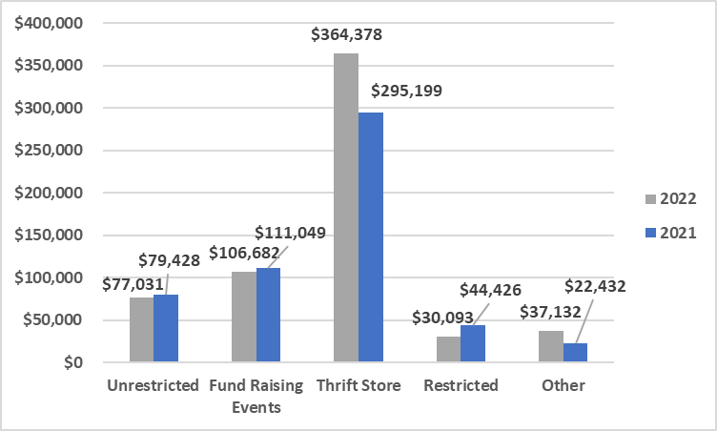
2022 & 2021 INCOME COMPARISON

Slide 4
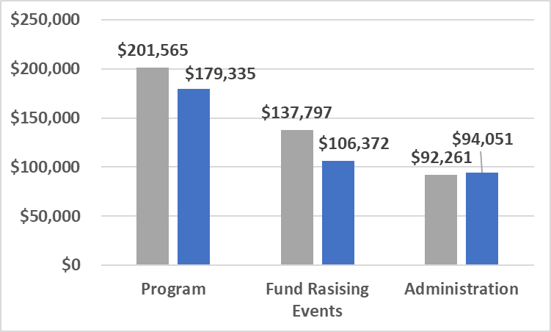
2022 & 2021 EXPENSE COMPARISON

Slide 5
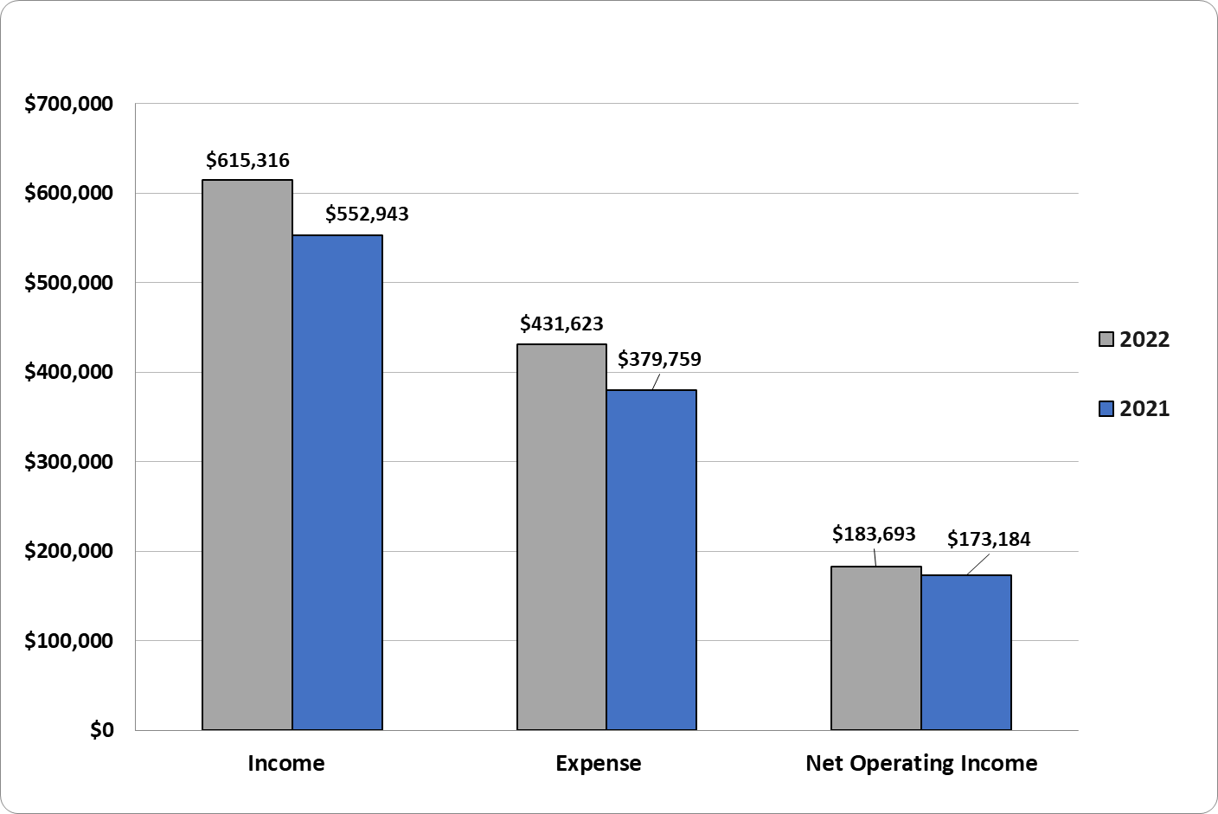
2022 & 2021 NET OPERATING INCOME
LESS SHELTER RELATED EXPENSES

Slide 6
SHELTER STATISTICS
BOB KORTS

Slide 7
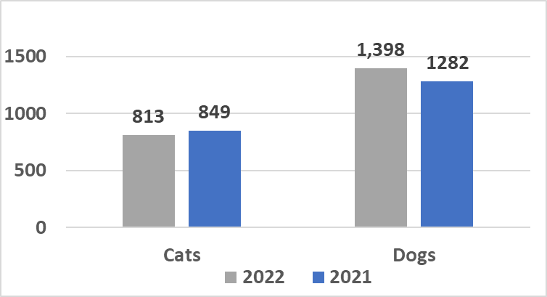
ANIMAL INTAKE

Slide 8
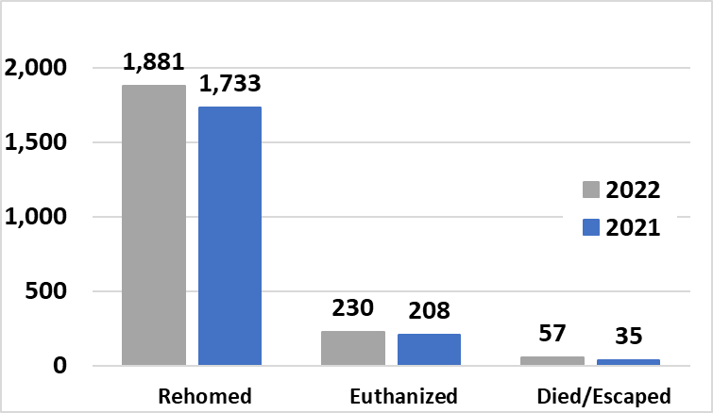
ANIMAL OUTCOME

Slide 9
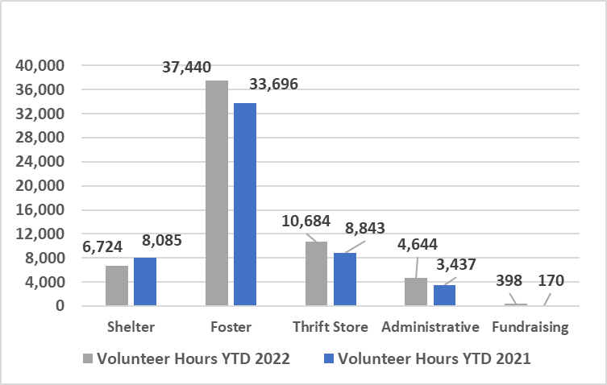
VOLUNTEER HOURS

Slide 10
A LITTLE BIT OF HISTORY
BOB KORTS

Slide 11
A LITTLE BIT OF HISTORY
2015 WE STARTED TO TALK SERIOUSLY ABOUT A NEW SHELTER
FOUND OUT WE DIDN’T KNOW WHAT WE WERE DOING.
HIRED A CONSULTANT
FOLLOWED HER ADVICE, FIRST CHRISTMAS APPEAL LETTER
BROUGHT IN $25K
2017 HAD A $100K DONATION TO BUY A LOT ON INDUSTRIAL DRIVE
2018 HIRED SAM MOSER TO DESIGNED A SHELTER THAT FIT THAT PROPERTY
STILL DIDN’T HAVE MONEY TO BUILD.
STARTED EXPLORING THE FEASIBILITY OF A CAPITAL CAMPAIGN
MOVED THRIFT STORE TO 3949 HWY 411
2019 JIM BARRETT STARTED NEGOTIATIONS WITH THE COUNTY FOR A MOU. IT TOOK THREE YEARS.
2020 COUNTY DEFUNDED THE SHELTER

Slide 12
A LITTLE BIT OF HISTORY
2021 THE KEFAUVER FAMILY DONATED 3.29 ACRES ON KEFAUVER LANE FOR A NEW SHELTER
BACK TO THE DRAWING BOARD TO DESIGN A SHELTER TO FIT THIS LAND.
THE PROPERTY WAS IN THE COUNTY NOT THE CITY
TOOK ONE FULL YEAR FROM THE TIME THE DONATION WAS MADE UNTIL WE HAD TITLE.
HAD TO WAIT TWO MONTHS FOR A SURVEY
KEFAUVER LANE WAS NOT A DEDICATED ROAD. HAD CONVINCE MADISONVILLE THAT IT WAS DEDICATED.
THERE WAS NO SEWER LINE ON KEFAUVER LANE
PROPERTY WAS ANNEXED TO THE CITY OF MADISONVILLE.
WATER SYSTEM
POLICE PROTECTION
FIRE PROTECTION

Slide 13
A LITTLE BIT OF HISTORY
2022 CAPITAL CAMPAIGN
HAVE RAISED APPROXIMATELY 2 MILLION IN 0NE YEAR.
BUILDING PLANS WERE APPROVED BY THE BOD
2023 ADVERTISED FOR BIDS IN JANUARY
SIGNED CONTRACTS MARCH 2023
CONSTRUCTION TO BEGIN 2Q 2023

Slide 14
CAPITAL CAMPAIGN
CHERYL ULMER

Slide 15
Capital Campaign
Steering Committee formed May 2022
Members
Cheryl Ulmer, Chair
Teresa Underwood
Jim Barrett
Scott Shapiro
Standard campaign steering committee is comprised of 5-10 people and extends over 2-5 years.
A small group of people have raised an impressive amount of donations and pledges in a relatively short amount of time. It will take everyone to reach our goal.
To date the committee has raised ~$2.5 million of the $4.3 million in the building fund. Board and other restricted donations comprise the rest.
We are $500,00 short of our phase 1 goal
The committee will continue to campaign for additional donations and pledges until we open our doors in 2024. Date TBD.

Slide 16
THE NEW SHELTER
BOB KORTS

Slide 17
New Shelter Project
Recent Developments
Bids for the project were requested and received. Three firms bid, two declined.
The Board selected Rouse Construction, the low bidder.
A large grant application from a foundation was declined but a very large pledge was received from a donor.
To eliminate the gap between the cost and the funds available Rouse identified several possible cost reductions in materials. Also, our Design and Build Committee identified the construction elements that could be delayed until after the initial build (added back as additional funds are raised).
The Board decided to begin construction, with cost reductions, as soon as possible.
The contract with Rouse was signed
A presentation was made to the county commissioners (6 of 10 are newly elected)
emphasizing that both parties need to be committed partners.
The county indicated a willingness to increase their payment under the contract.
Contract to be signed at the ground breaking.

Slide 18
What have we contracted to build?
The entire structure, including the exterior shell of all phases as designed less:
Delayed items
The slab, the interior build out, and furnishings of Phases 2 and 3
-Animal Control Intake -Phase 2
-A storage room - Phase 2
-The meeting room -Phase 3
-MCFA office area - Phase 3
Perimeter fencing and dog exercise areas
Changes in materials to lower costs but not functionality.
Total cost with architect fees, site preparation, furnishings, etc is approximately $4.5M

Slide 19
This initial build will provide
An operational animal shelter built to construction specifications for a long life
A nice place to work or visit
High end HVAC systems for a healthy facility
Proper lighting throughout the building
Wider aisles for efficient operation
Ten percent more dog housing, 20% more cat housing
Medical Suite, both exam and surgery, with sufficient space
Both public and staff restrooms

Slide 20
This initial build will provide
For Dogs
Proper air exchange for dog health
Industry standard dog housing , interior and exterior compartments for
adult dogs with guillotine doors separating compartments
Mason FRP panel kennel walls, Mason chain link surrounds and gates
Premium epoxy resin surface coatings
Dog laundry room with sufficient space for two sets of appliances
Noise suppression
Separate isolation kennels
Combination Get Acquainted and Animal Behavioral Assessment (CBA) room

Slide 21
This initial build will provide
For Puppies
Proper air exchange for puppy health
Two compartment puppy pens
Separate isolation area
For Cats
Proper air exchange for cat health
Three cat rooms with proper spacing of cat suites
Daylight in each room
Separate cat Get Acquainted room
A cat workroom for food prep, supplies storage, laundry, etc
Separate isolation room

Slide 22
When will the build begin?
We can begin the build when the following two items are complete
-“Construction” financing is obtained.
(must be complete before any groundbreaking)
-The contract with the county is acceptable to both parties
(to be signed at groundbreaking)
How long will it take to build?
Rouse has estimated the construction period to be 55 weeks after site prep
Site prep is 5-6 weeks

Slide 23
Next Steps
Complete the loan process with the selected bank
Finalize the contract with the county to be signed at groundbreaking
Continue the Capital Campaign to raise the remaining funds
Develop transition plan (closing the current shelter and opening the new)
Begin working on operational issues, including shelter policies and procedures
The Challenge
Raising the remaining funds to complete the entire project (approximately $500,000)
Funding the operation of the shelter, year after year.

Slide 24
“Musts” for Success
MCFA must raise its revenue every year
Thrift Store must remain viable and grow
New fundraising initiatives must be identified and implemented
The County and Municipalities must be committed partners
Sharing the burden of cost increases

Slide 25
Funding the Operation of the Shelter
Under the current agreement MCFA will pay more than half the > $500,000 annual cost of operation
MCFA’s cost of Salaries and Benefits for shelter staff is greater than the County’s payment
A healthy place to work for people and animals, plus a facility much larger than the current collection of buildings, will drive electric and gas costs $50,000/yr higher.
Building insurance is estimated at $15,000/yr
Administrative costs, currently borne by the county, will be incurred by MCFA (e.g. payroll)
All animal care costs MCFA pays now are rising
Based on cost estimates our 5 year plan shows little, if any, net income
Inflation will have a serious impact, costs will rise every year

Slide 26
VOTING RESULTS
DEBORAH SMITH

